Slide 1
Question and Answering System
Sikha P
Partner Solution Desk

Slide 2

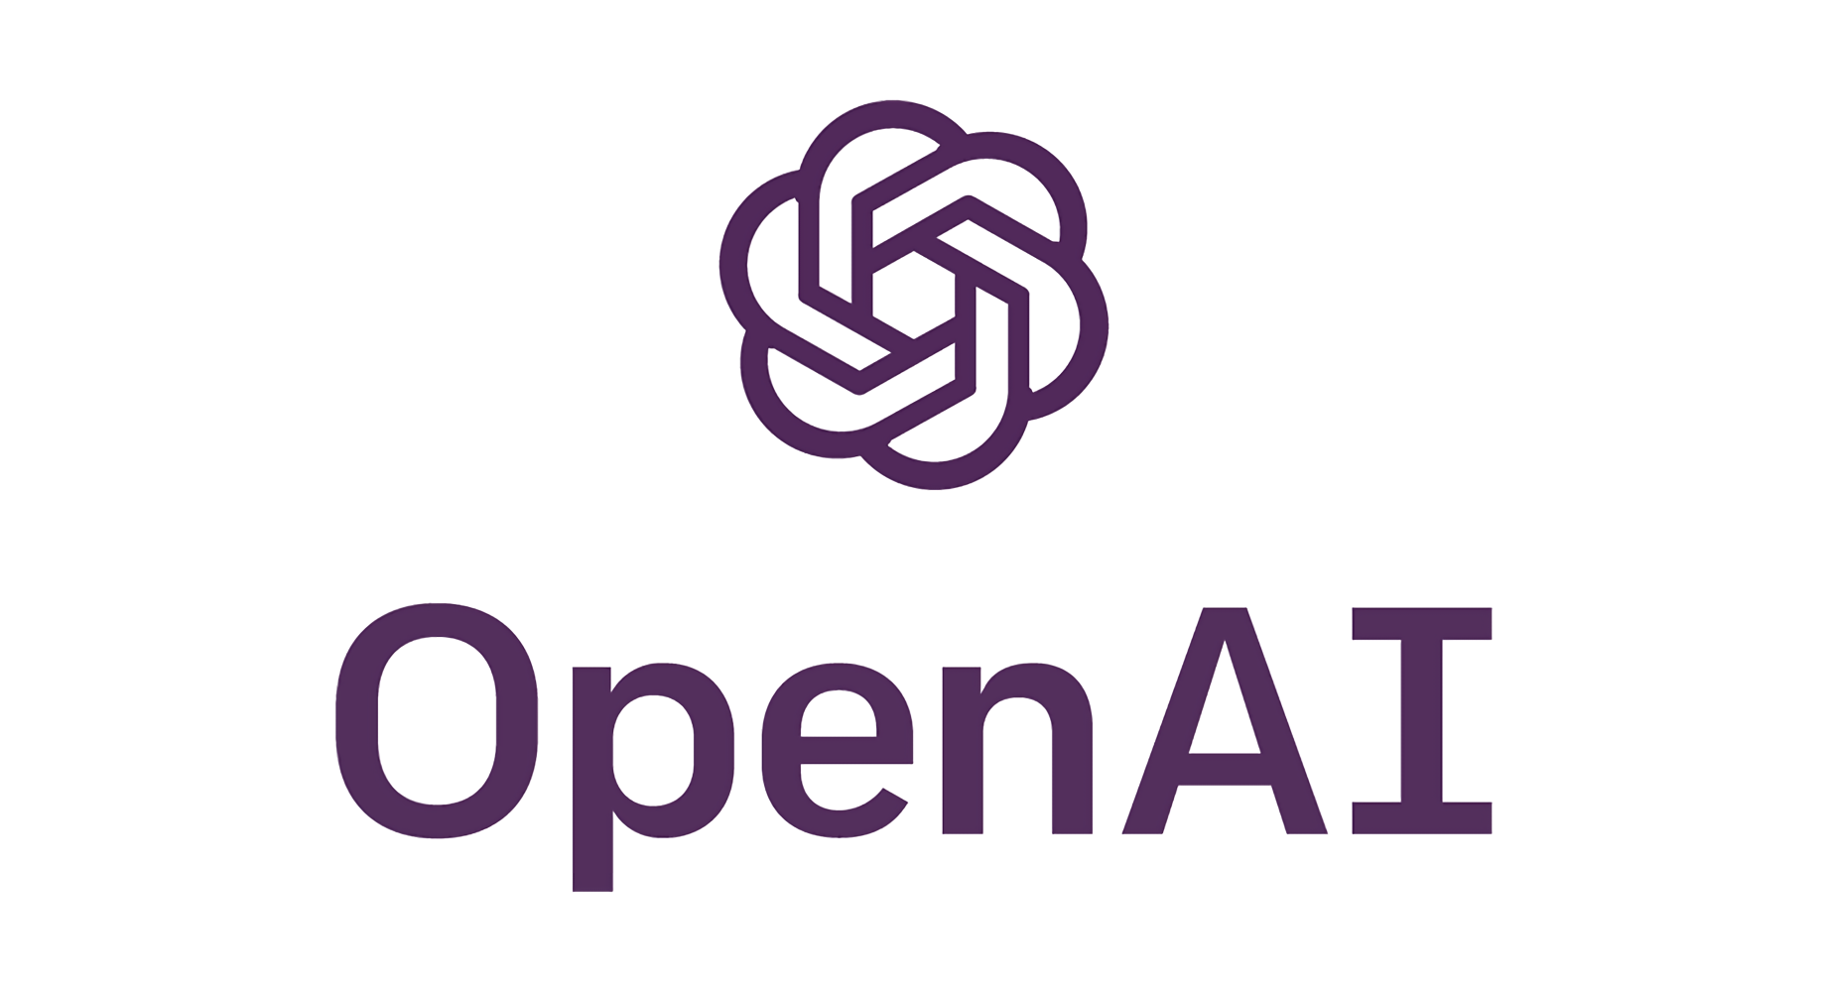


Question and Answering System
Problem
It is difficult to get instant answers to our questions from a document which has large volume of data without reading the whole document content.
Solution
Using A360 AARI Process and tools like OpenAI, LangChain, and Pinecone, we can perform sophisticated searches on this data, allowing us to quickly and efficiently find the information we need. Retrieve relevant contexts to queries from Pinecone and pass these to OpenAI and LangChain to generate an answer backed by real data sources
Results
Tested with different variety of documents with large data and results are meaningful & accurate. The solution is giving summarized answer for the question from the big data document.
Function & Industry
This use case can be used in all the industries where we have a lot of questions about any document content. The document can be a book , a legal contract , a product documentation etc.

Slide 3








RPA Bot
Question?
Answer
Query Embedding
Text chunk 1
Embedding 1
Build
Semantic Index
LLM Generative AI
Extract Content
Split in Chunks
Text chunk 2
Embedding 2
Semantic Search
Pdf /docx
300+ Pages
Text chunk 3
Embedding 3
…………
…………
Text chunk N
Embedding N
Knowledge Base
Ranked results
LangChain & Open AI
LangChain & Pinecone

Slide 4
Process Flow
AARI Process + RPA Bot + Open AI + LangChain + Pinecone
STEP 1
STEP 5
AARI
- User selects the Subject from AARI Form
- Upload a excel file which has a set of queries to be answered based on a chosen subject to AARI Form
- Submit the AARI Form
Displays the modified excel file content (questions & answers) in a table element inside AARI Form
Human Task to review the answers , modify the answers if required and submit the final data.
STEP 2
STEP 4
STEP 6
RPA Bot downloads the uploaded file from AARI Storage & save it locally
Loop through each row in the Excel file and pass the questions to the Python logic
Also, find the correct document for the select subject to process the question
Modify the excel file with answer, once the bot gets the answer for a question.
Continue the loop until the last question
Final Data will get saved as an excel file locally
A360 RPA Bot
Python script which is internally using LangChain , OpenAI , Pinecone Libraries will take each question from the file and return the answers
STEP 3
Python script which is internally using LangChain , OpenAI , Pinecone Libraries. This script will take each question from the file, process it based on the selected subject related document and returns the answer.
OpenAI + LangChain +
Pinecone

Slide 5

Demo

